Slide 1
Autonomous Robotic Aerial Vehicle: ARAV Control in Complex Environments
Akash Sharma
Tutors:
Raghuvamsi Deepthimahanthi Yves Briere

Slide 2
Table of Contents
What is the Project about?
The Goal of the Project
Software Architecture
Current Status and Problems
Solutions Proposed
Hybrid Module
Future Work

Slide 3
What is the Project about?

Slide 4
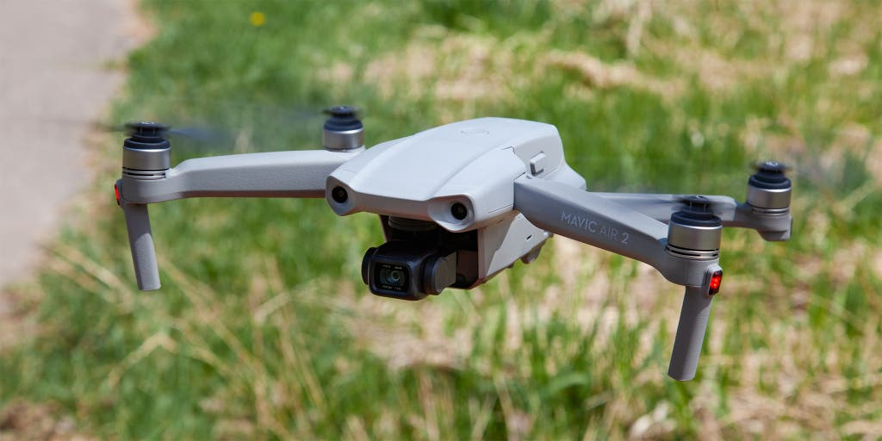
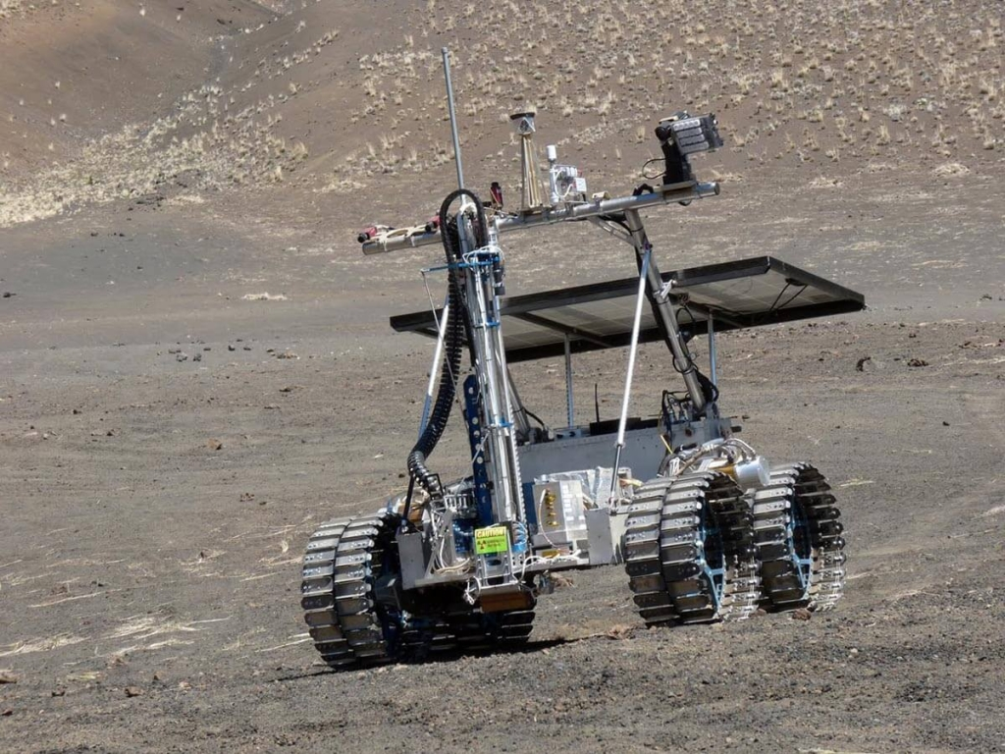

Background
Capable of covering large distances
Consumes more energy
Capable of traversing rough terrain
Does not consume a lot of energy
Hybrid vehicle capable of performing both kinds of activities
Completely autonomous
Notes:
The vehicle is designed after merging the technology of UAVs and ground rovers.
Applications of UAVs- surveillance, exploration, delivery, topography mapping.
Applications of ground rovers - Space missions for collecting soil samples and analyzing the terrain. This is because they are designed to be functionally robust in order to be able to traverse rough and unforgiving terrains.

Slide 5
The Goal of the Project

Slide 6
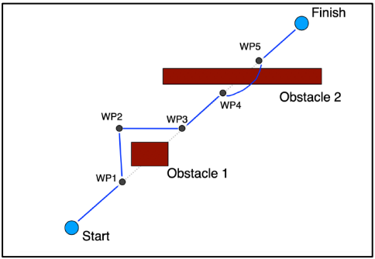
Main Goal
Create a vehicle capable of navigating across complex and uncertain environments filled with obstacles
Using 2 modes of transport available
Does this completely autonomously

Slide 7
Software Architecture

Slide 8
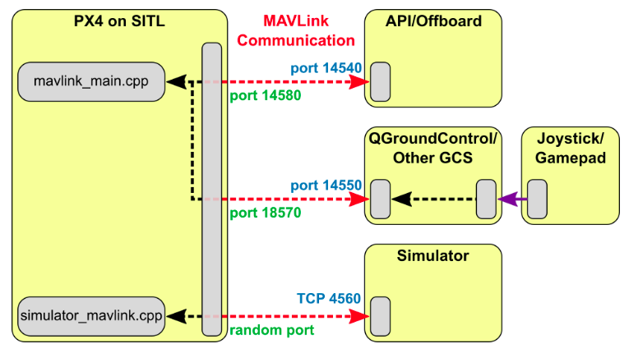

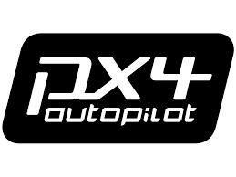

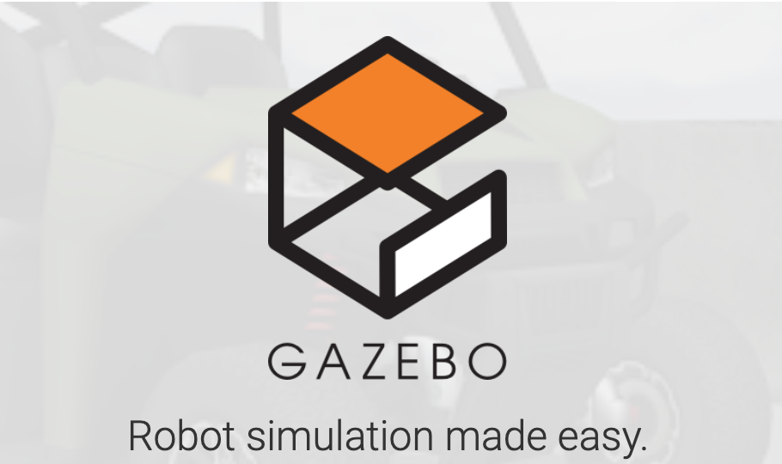
Software Architecture of the Vehicle
Notes:
PX4 communicates with Gazebo to receive sensor data from the simulated world and send motor and actuator values. It also communicates with QGC or an Offboard API like ROS to send telemetry from the simulated environment and receive commands.
MAVROS package available in ROS is used to establish communication between ROS and Pixhawk. This package enables the MAVLink communication protocol which is the supporting bridge between ROS and PX4.
MAVLINK is a communication protocol for sending and receiving messages. It standardized the types of messages that can be sent and enables bi-directional communication.
ROS - ROS has been used for developing the different modules that manage various functionalities of the vehicle, from path-planning and obstacle avoidance to high level ground and air control. ROS is an open-source development environment comprised of libraries, applications and different tools that can be utilized to develop and customize any kind of robot.
Gazebo - Gazebo is the chosen 3D simulator for testing the vehicle in simulation before the real test. It is another open-source real world simulator which can realistically simulate scenarios in indoor as well as outdoor environments. It offers a robust physics engine which makes simulating collisions easier. It can also simulate sensor feedback with noise through its various sensor models. Gazebo is also compatible with ROS which makes its utility much more convenient.
QGC - The QGC station is useful for real time monitoring and mission planning. This tool gives a comprehensive picture about the vehicle state, power and battery consumption which is useful to study the decision-making capabilities of the vehicles when it tries to conserve battery while navigating an optimum path.
PX4 - Pixhawk is the flight controller installed on the vehicle. The controller receives sensor data and adequately sends motor and actuator values.

Slide 9
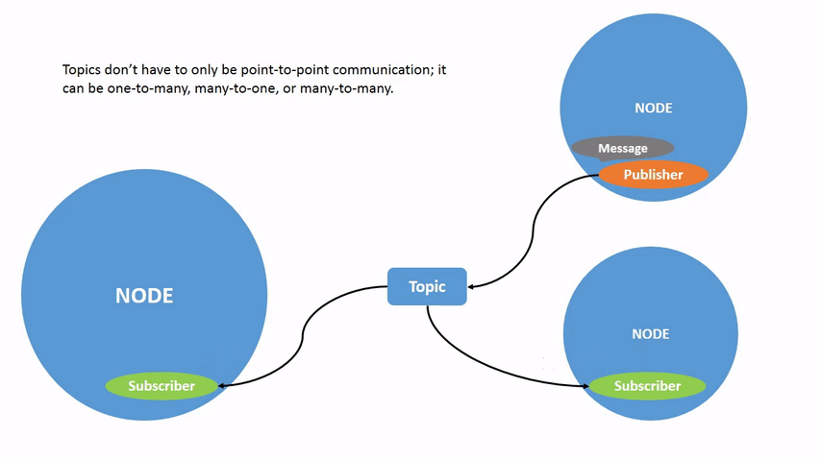
ROS Architecture
Point-to-Point Architecture
Supports multiple languages simultaneously
Supports flexibility and reusability
Notes:
ROS is an open-source development kit composed of different libraries and applications for robotics applications. It provides a software platform that can be used for research and prototyping as well as deployment and production. It supports usage of multiple languages and has been designed to be easily integratable with any project.
ROS Nodes: Essentially files of code that are executed when the node is run. These nodes can be written in different languages and still be run simultaneously.
ROS Topics: Instead of calling different nodes in order to share data with each other, these nodes communicate via ROS Topics that act as channels storing ROS Messages that are sent and received by these nodes.
Publishing and Subscribing: In order for a node to participate in communication, it must either publish on a topic or subscribe to a topic.
This kind of point-to-point architecture builds a network of nodes that works together to carry out different aspects of the robot's functionality.

Slide 10
Current Status

Slide 11
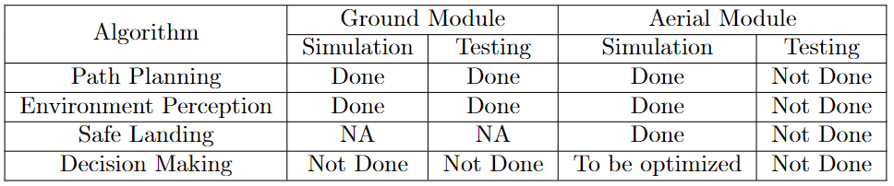
Current Status

Slide 12
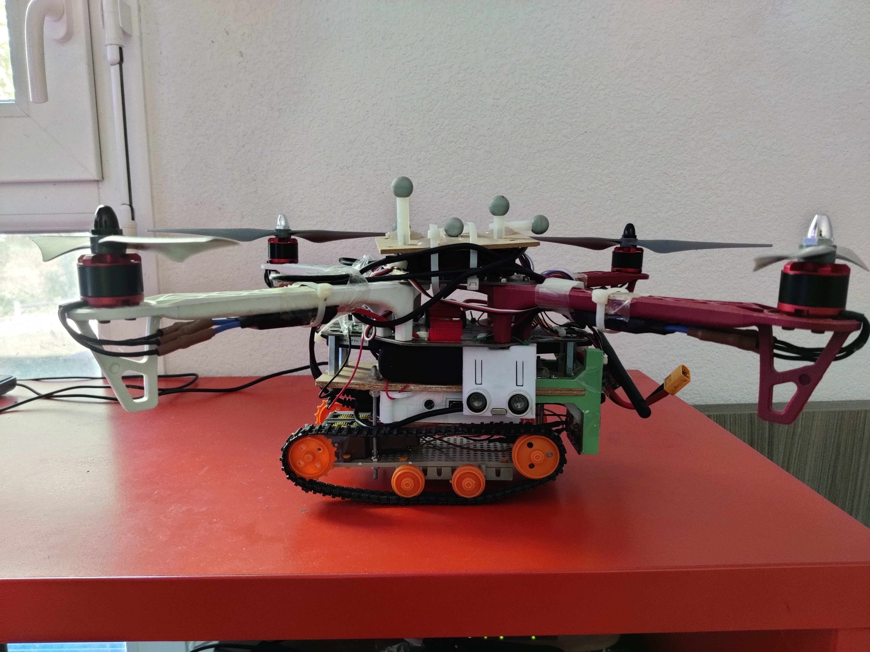
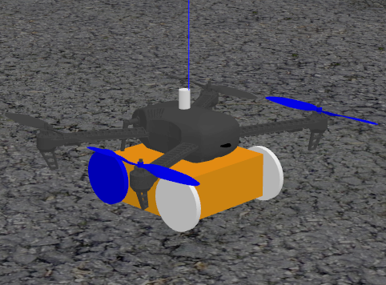
Prototype and Hybrid Model

Slide 13
Current Project Issues

Slide 14
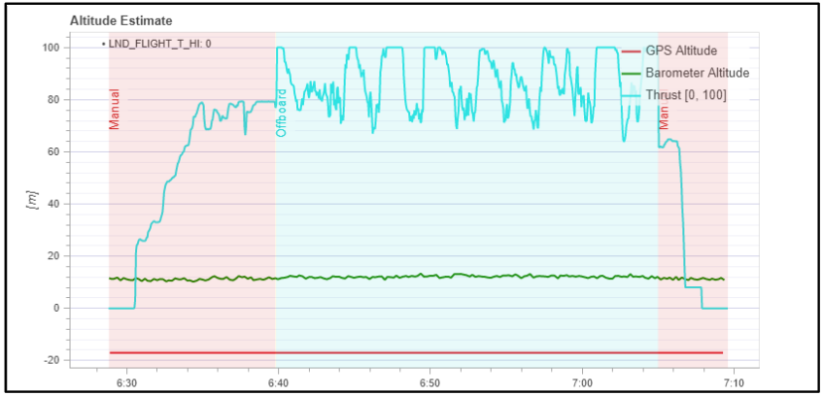
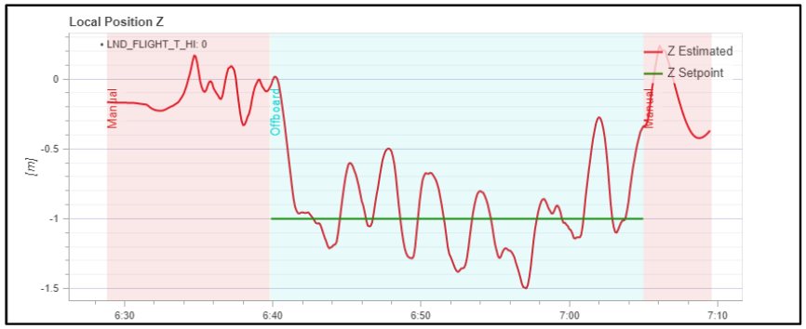
Current Project Issues
Aerial module not performing properly
Insufficient thrust margin at the current weight
PID controller not tuned
Vehicle not at the proper weight
SOURCE: K. Mallabadi and R. Dsouza. Autonomous robotic aerial vehicle: S3 project report. March, 2022

Slide 15
Solutions Proposed

Slide 16
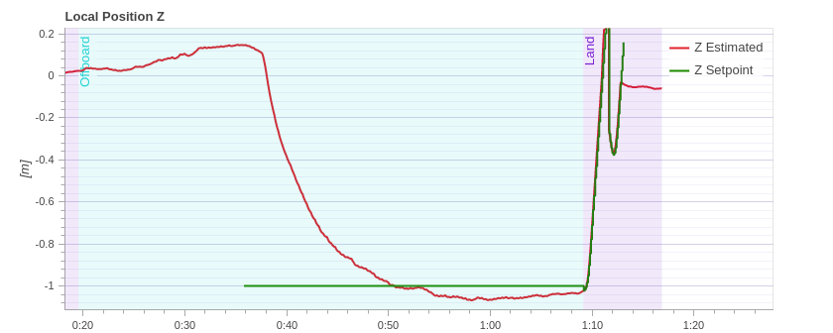
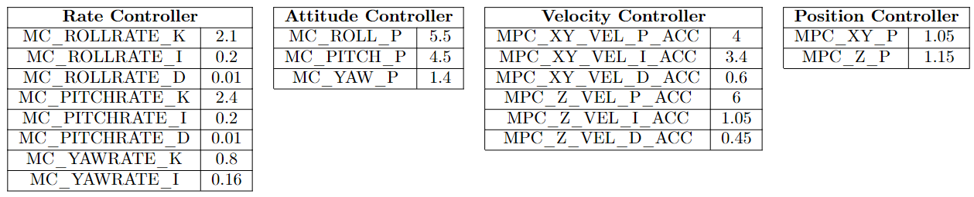
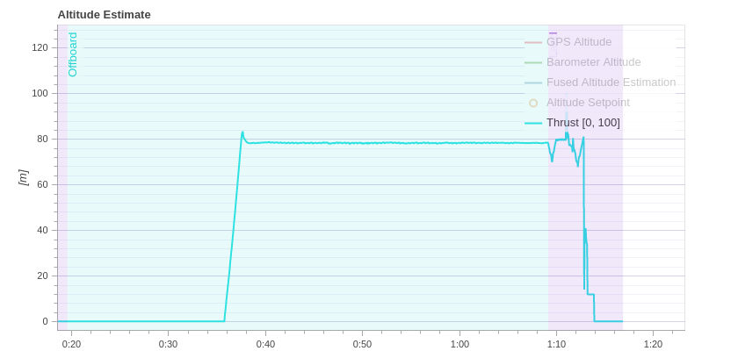
Tuning the PID controller
Vehicle tuned at 1.85kg of weight.
The vehicle flies but at a high nominal thrust of 80%.
Notes:
The previous students tuned the vehicle properly but could not implement the same values in the project. Since the gains implemented were the untuned ones, the transient thrust requirements saturate the thrust.

Slide 17
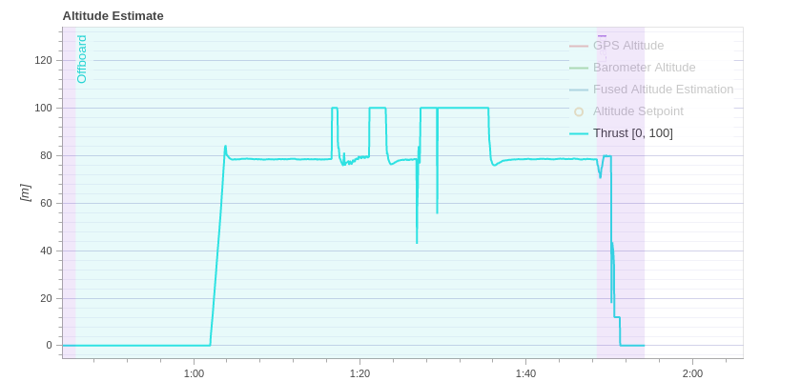

Slide 18
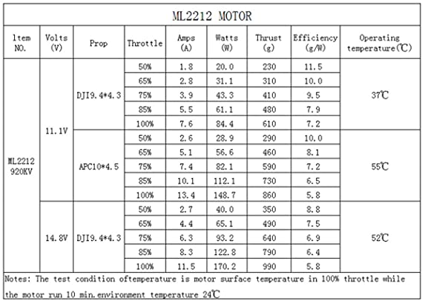
Propeller Optimization
Vehicle weight = 1850g
Weight to be handled by each propeller = 462g
SOURCE: 2212 920kV Motor Thrust Performance Datasheet

Slide 19
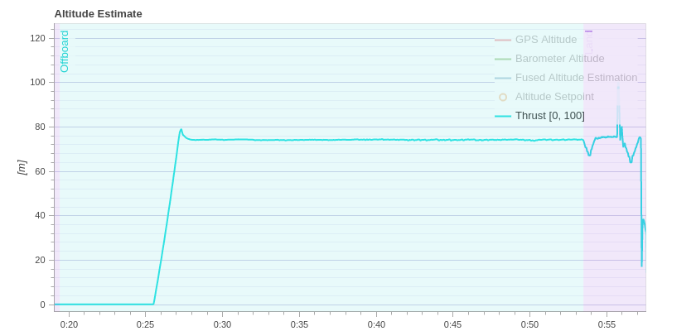
Weight Reduction
Thrust margin decreases to 74% after removing the power bank.
Simulated with the 9450 type propellers
Notes:
Weight of 10000mAh battery = 175g

Slide 20
Hybrid Module

Slide 21
Hybrid Module Optimization
Minimize power consumption while meeting deadlines
Fly inside the flight domain, but drive outside it
Rate of increase of the flight domain depends on user inputs:
Final coordinates
Mission time
Flight domain
Final Coordinates (x,y,z)
Sf
Vg
Switching Point
Vf
θ
Initial Position
Sg

Slide 22
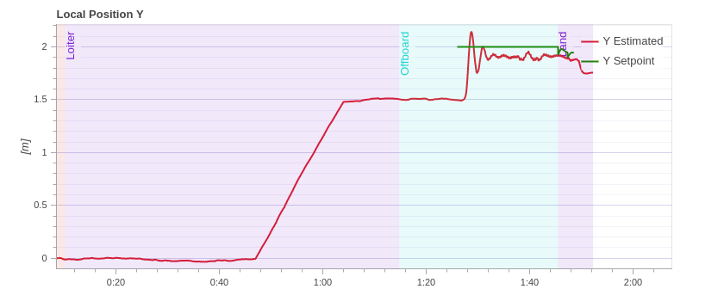
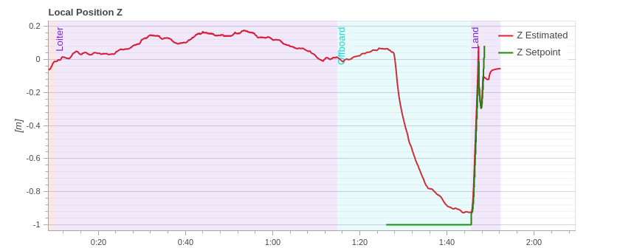
Hybrid Module – Flight Domain

Slide 23
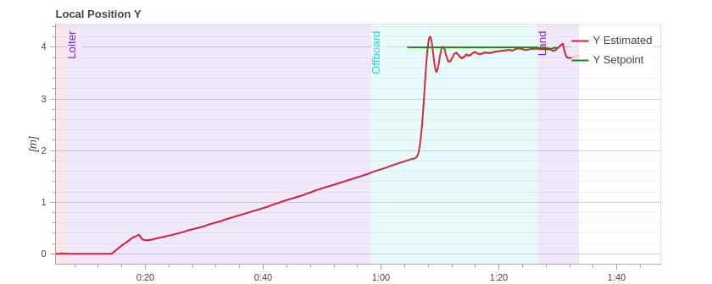
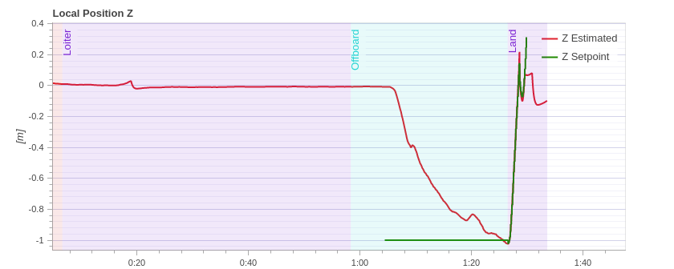
Hybrid Module – Smooth Switch

Slide 24
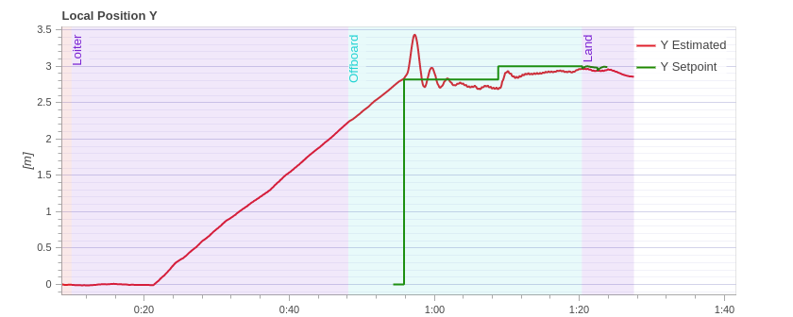
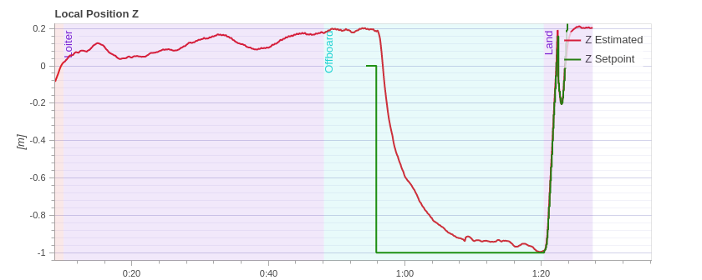
Hybrid Module – Safety Protocol (air)

Slide 25
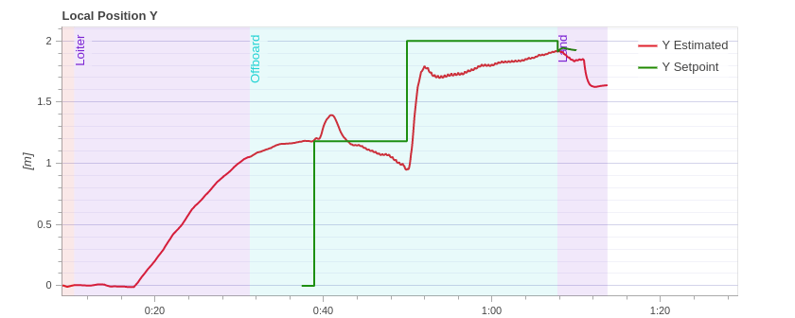
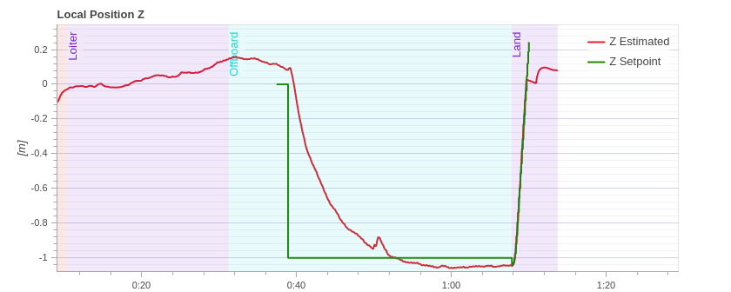
Hybrid Module – Safety Protocol (ground)

Slide 26
Future Work
SMACH package to organize the code and debug errors
Further develop the code:
Test more use cases involving obstacles
Test on the actual vehicle.
Address latency issues to make operation truly real time
Notes:
SMACH is capable of building hierarchical state machines.

Slide 27
Thank you for your time

